Slide 1
Google Cloud Vision API
ECET 12 MP1 Seminar Presentation
By Team 09: Abhishek Hariharan, Jonathan Wong

Slide 2
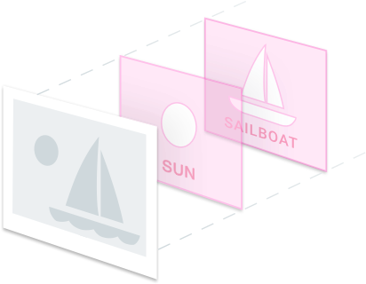
Google Cloud Vision API
Understands the content of an image
Machine learning models
Analyzes images upon request
Classifies images
Improves as it is used

Slide 3

Brief Intro to Server Technology
Client-Server Relationship
Client requests from the server
Server provides information to the client
Representation State Transfer (REST) API
Uses resources (similar to objects in C++); can be grouped
HTTP Protocols -> POST to update/create
JSON (JavaScript Object Notation)

Slide 4
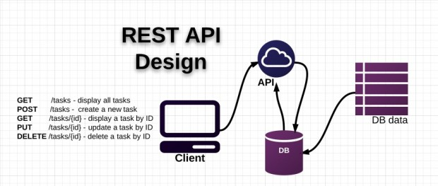

Slide 5
Cloud Vision Features
Label detection - categorizes items in the image
Needed for classifying cartons, aluminum cans and water bottles
Web detection - searches the internet for similar photos and images
Logo detection - detects the logos of popular products
Landmark Detection - detects landmark structures, natural or man made

Slide 6
More Features
Optical Character Recognition - detects and extracts text for many languages
Face detection - also detects emotional states (however, recognition is not supported)
Image attributes - detects dominant colors and gives crop hints
Explicit Content Detection

Slide 7
Supported Languages
Supported Images
C#
Go
Java
Node.JS
PHP
Python
Ruby
JPEG
PNG8
PNG24
GIF
Animated GIF (first frame)
BMP
WEBP
RAW
ICO

Slide 8
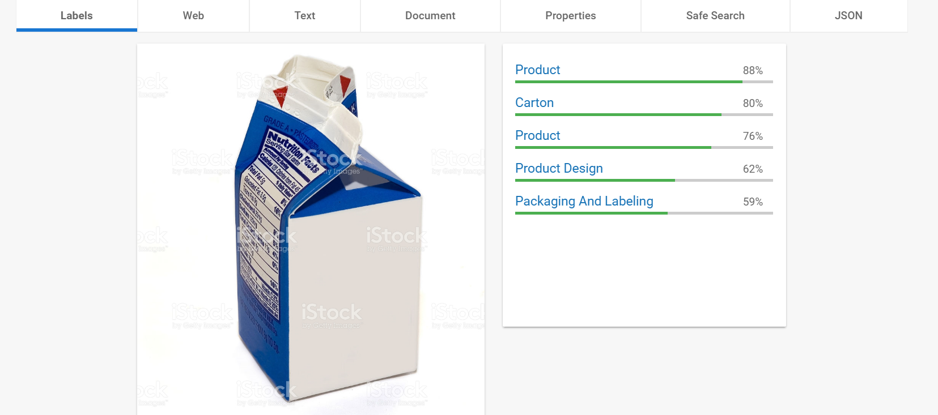
Milk Carton Identification

Slide 9
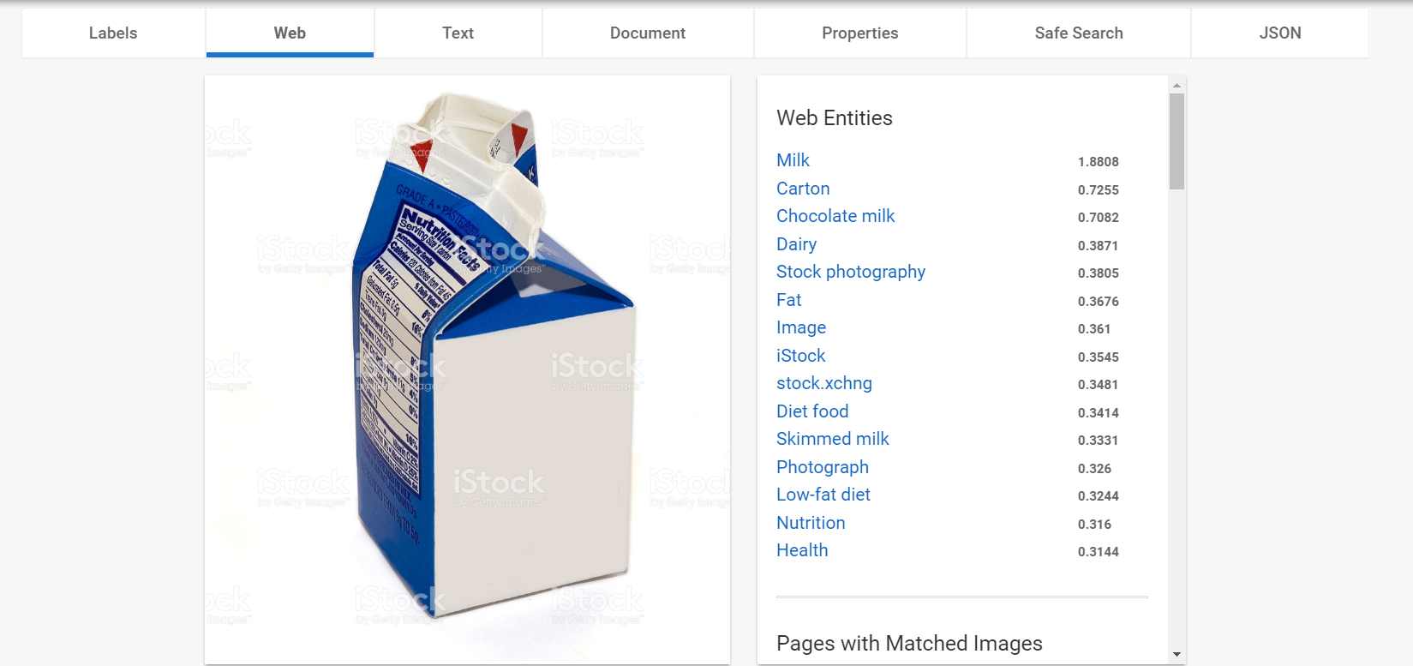
Web Detection Example

Slide 10
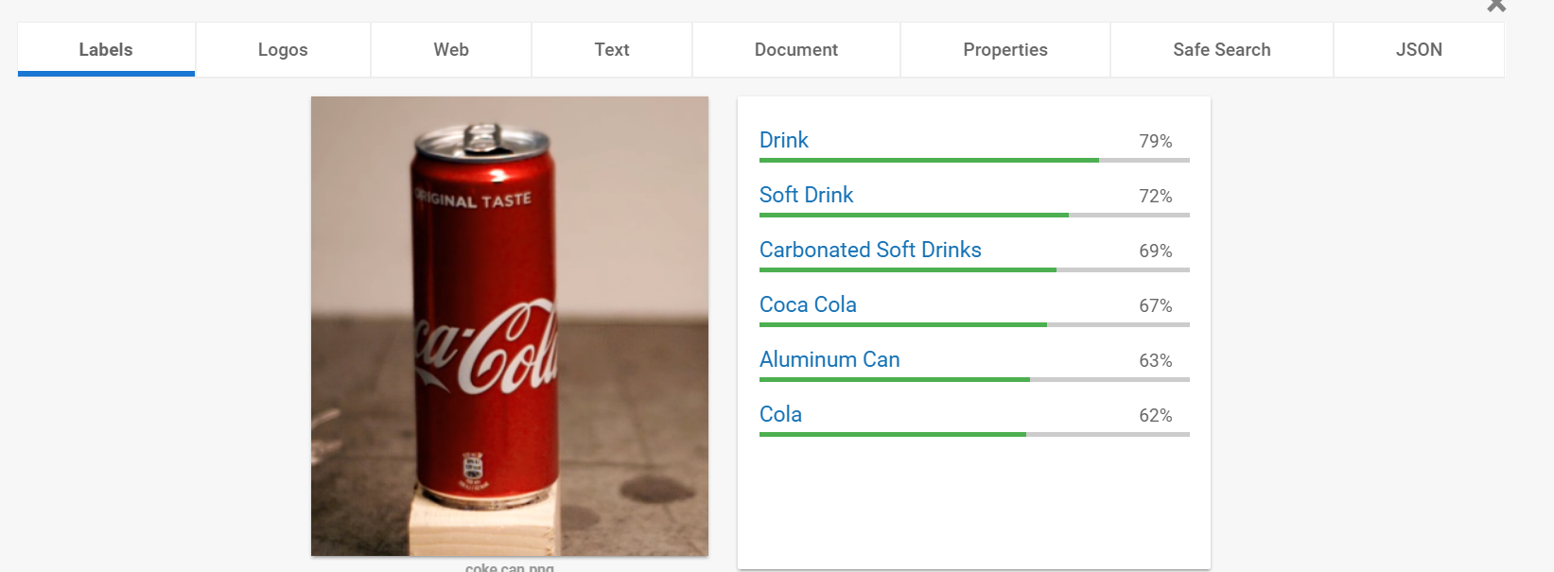
Aluminum Can Detection

Slide 11
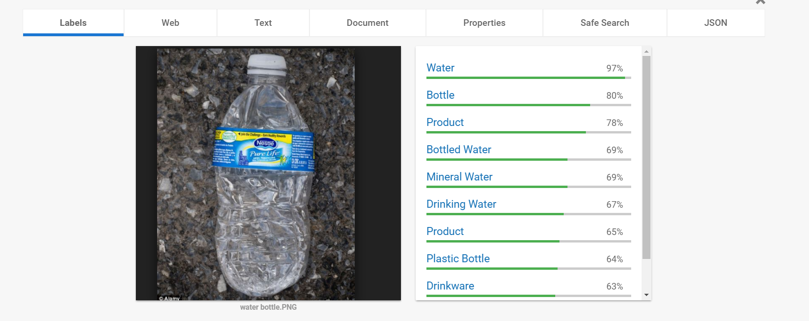
Water Bottle Identification

Slide 12


Connection to the IRS
Object Recognition: mechanism to identify and categorize recyclable material
Gives Percentages (certainty of identification)
Use the category with the highest percentage certainty
Plan: Take identified labels (from JSON returned text), parse through and find each label and its respective percentage
Interface with Raspberry Pi

Slide 13
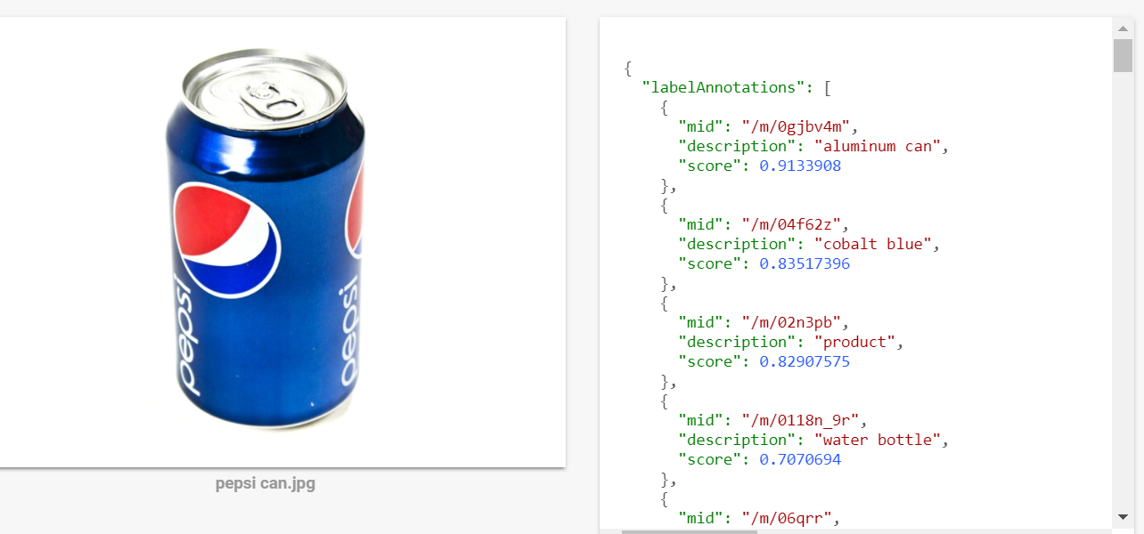
Connection to the IRS (contd.)

Slide 14
Sources Used
https://www.tutorialspoint.com/restful/restful_introduction.htm
https://eventespresso.com/features/rest-api/
http://restful-api-design.readthedocs.io/en/latest/resources.html
https://cloud.google.com/ml-engine/
https://cloud.google.com/vision/
https://www.dexterindustries.com/howto/use-google-cloud-vision-on-the-raspberry-pi/

